Slide 1
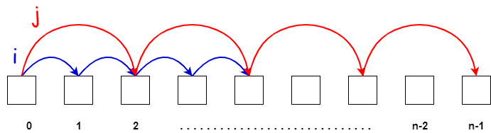
Two Pointers

Slide 2
Lecture Flow
Pre-requisites
Definitions
Different Variants
Things to Pay Attention (common pitfalls)
Practice Questions
Resources
Quote of the Day

Slide 3

Pre-requisites
Basic flow control (for, while loops)
Linear data structures

Slide 4
Definitions

Slide 5
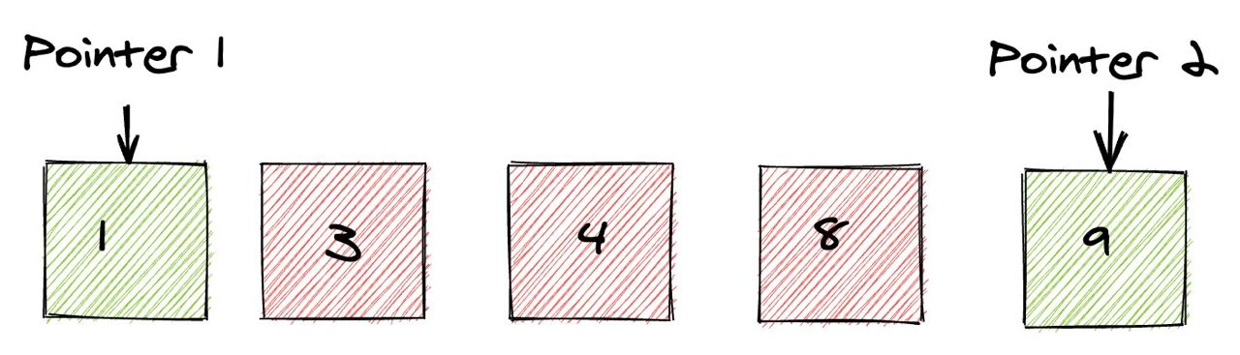
Two Pointers technique is the use of two different pointers (usually to keep track of array or string indices) to solve a problem involving said indices with the benefit of saving time and space.

Slide 6

Different Variants

Slide 7
Variants
Variant I: Parallel Pointers
Variant II: Pointers on Separate Arrays
Variant III: Colliding Pointers
Variant IV: Seeker and Placeholder
Variant V: For-While Combo

Slide 8
Variant I: Parallel Pointers

Slide 9
Problem Pattern
Given an array of integers, determine if it is sorted non-decreasing order.
Input
An array of integers.
Output
True or false, whether or not the array is sorted.

Slide 10
Approach Pattern
In this problem, we only need to look at two consecutive values. This is because for three consecutive numbers a, b, and c, if a <= b and b <= c, then a <= c.
The two pointers will iterate parallel to each other, until the right-most one reaches the end of the array.

Slide 11
Practice
Problem Link

Slide 12
Implementation
def isSorted(nums):
left = 0
right = 1
size = len(nums)
while right < size:
if nums[left] > nums[right]:
return False
left += 1
right += 1
return True

Slide 13
Variant II: Pointers on Separate Arrays

Slide 14
Problem Pattern
You are given two arrays, sorted in non-decreasing order. Merge them into one sorted array.
Input
Two sorted arrays of integers.
Output
The merged array.

Slide 15
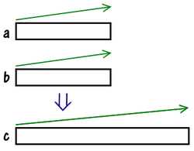
Approach Pattern
What is this task? We are given two arrays, a and b, sorted in ascending order. We want to combine the elements of these arrays into one big array c, also sorted in ascending order.

Slide 16
The easiest way to do this is with the following algorithm:
Collect all the elements into one big array;
Sort it with any sorting method built into your language.
Such an algorithm will take time O((m+n) ⋅ log(m+n))

Slide 17
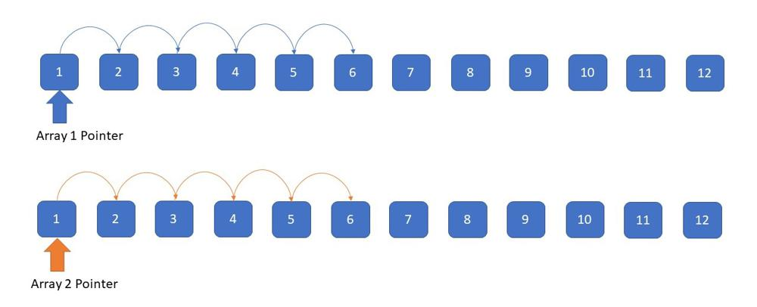
Efficient Approach: Pointer on Separate Arrays
Two arrays or Lists, each has been assigned a pointer

Slide 18

Simulation
How do we merge them into one sorted array?
To answer this question, let's understand which element will be in the first position in this array. Of course, this is the smallest element among all in a and b. The smallest element of a is at the beginning of the array, same as with b.

Slide 19
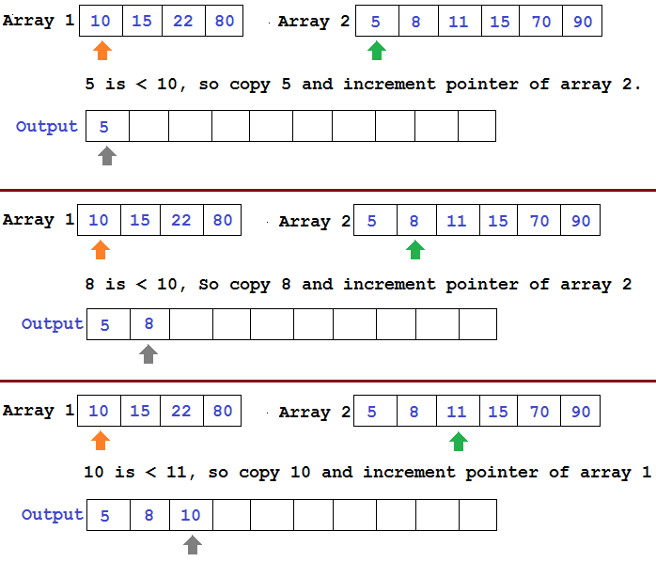
Simulation

Slide 20
Practice
Problem Link

Slide 21
Implementation
def mergeLists(list1, list2):
merged = []
first, second = 0, 0
while first < len(list1) and second < len(list2):
if list1[first] < list2[second]:
merged.append(list1[first])
first += 1
else:
merged.append(list2[second])
second += 1
merged.extend(list1[first:])
merged.extend(list2[second:])
return merged

Slide 22
Variant III: Colliding Pointers

Slide 23
Problem Pattern
Given an array of integers that is sorted in non-decreasing order, find two numbers such that they add up to a specific target number (it is guaranteed that at least one pair exists).
Input
A sorted array of integers and a target number.
Output
Two numbers from the array that sum up to the target number.

Slide 24
Brute Force Approach
We could implement a nested loop finding all possible pairs of elements and adding them.
for i in range(n-1):
for j in range(i+1):
if arr[i] + arr[j] == target:
return [arr[i], arr[j]]
return []
Time complexity: O(n²)

Slide 25
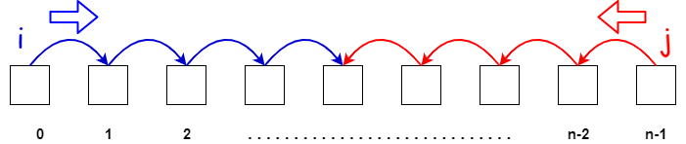
Efficient Approach
One pointer starts from beginning and other from the end and they proceed towards each other.

Slide 26
Approach
Since the array is sorted, we can make some general observations:
Smaller sums would come from the left half of the array
Larger sums would come from the right half of the array
Therefore, using two pointers starting at the end points of the array, we can choose to increase or decrease our current sum however we like.
The basic idea is that:
If our current sum is too small, move closer to the right.
If our current sum is too large, move closer to the left.

Slide 27
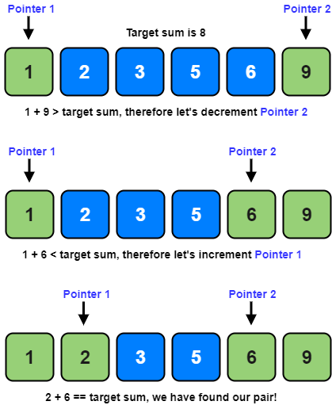
Simulation

Slide 28
Practice
Problem Link

Slide 29
Implementation
def twoSum(nums, target):
left = 0
right = len(nums) - 1
cur_sum = 0
while nums[left] + nums[right] != target:
cur_sum = nums[left] + nums[right]
if cur_sum < target:
left += 1
else:
right -= 1
return [nums[left], nums[right]]

Slide 30
Variant IV: Seeker and Placeholder

Slide 31
Approach Pattern
This approach is used when we are trying to group elements based on some criteria and the array has to be modified in place.
One pointer is used to seek valid elements for the group, and the other is used to keep track of the next valid position for an element.
Notes:
As soon as the seeker finds a valid target, it places it on the position being held by the placeholder. Then, the placeholder moves on to the next valid position, and the seeker continues its search.

Slide 32
Problem
You are given an array, group all non-zero elements to the beginning of the array while maintaining their relative order. The modification must be done in-place.
Input
An array of integers.
Output
The array, modified in-place, such that all non-zero numbers are at the beginning of the array.

Slide 33
Approach
Any approaches to solve this problem?

Slide 34
Approach
One pointer will iterate over the array, finding non-zero elements. The other pointer will point to the next valid position for a non-zero element.

Slide 35
Simulation
[0,4,0,1,3]

Slide 36
Simulation
[0,4,0,1,3]
Holder
Seeker

Slide 37
Simulation
[0,4,0,1,3]

Slide 38
Simulation
[4,0,0,1,3]

Slide 39
Simulation
[4,0,0,1,3]

Slide 40
Simulation
[4,0,0,1,3]

Slide 41
Simulation
[4,1,0,0,3]

Slide 42
Simulation
[4,1,0,0,3]

Slide 43
Simulation
[4,1,3,0,0]

Slide 44
Simulation
[4,1,3,0,0]

Slide 45
Practice
Problem Link

Slide 46
Implementation
def moveNonZeroes(nums):
holder = 0
seeker = 0
while seeker < len(nums):
if nums[seeker] != 0:
nums[seeker], nums[holder] = nums[holder], nums[seeker]
holder += 1
seeker += 1

Slide 47
Variant V: For-While Combo

Slide 48
Approach Pattern
The for-while combination is used when one pointer moves one step at a time, but the other one moves multiple steps at a time.
This is usually applied to problems in which the position of one pointer is directly dependent on the position of the other.

Slide 49
Problem
You are given two arrays, sorted in non-decreasing order. For each element of the second array, find the number of elements in the first array are that strictly less than it.
Input
Two sorted arrays.
Output
A single sorted array containing all elements from both arrays.

Slide 50
Approach
Any approaches to solve this problem?
Notes:
prunıng

Slide 51
Approach
What would a brute force approach look like?
For every element in the second array, iterate over the first array and count the ones that are smaller than it.
This is very inefficient - O(n²)

Slide 52
Approach
Remember that both arrays are sorted.
This means that if there are n elements that are less than a specific target, then there is at least n guaranteed elements for the next target too.

Slide 53
Simulation
We are going to move pointer j over array b and move i over array a until we find an a_{i} from array a that is greater than or equal to b_{j}. At this point, the value of i will represent the number of elements in a that are less than b_{j}.

Slide 54
Simulation
a = [2,2,5,6]
b = [3,4,6,8]
C = []

Slide 55
Simulation
a = [2,2,5,6]
b = [3,4,6,8]
C = []

Slide 56
Simulation
a = [2,2,5,6]
b = [3,4,6,8]
C = [2]

Slide 57
Simulation
a = [2,2,5,6]
b = [3,4,6,8]
C = [2,2]

Slide 58
Simulation
a = [2,2,5,6]
b = [3,4,6,8]
C = [2,2]

Slide 59
Simulation
a = [2,2,5,6]
b = [3,4,6,8]
C = [2,2,3]

Slide 60
Simulation
a = [2,2,5,6]
b = [3,4,6,8]
C = [2,2,3]

Slide 61
Simulation
a = [2,2,5,6]
b = [3,4,6,8]
C = [2,2,3,4]

Slide 62
Practice
Problem Link

Slide 63
Implementation
def countSmaller(nums1, nums2):
smaller_counts = []
first = 0
for second in range(len(nums2)):
while first < len(nums1) and nums1[first] < nums2[second]:
first += 1
smaller_counts.append(first)
return smaller_counts

Slide 64
Common Pitfalls

Slide 65
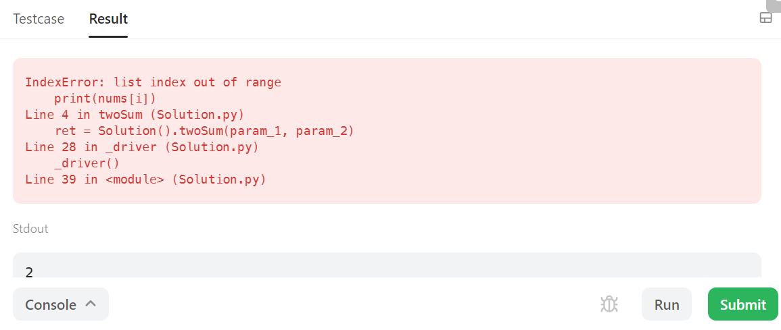
Index out of Bounds
Trying to access elements using indices that are greater (or equal to) than the size of our array will result in this exception.

Slide 66
2. Look out for pointer Condition
One common mistake we make while doing two pointer problems is not paying attention to our guard condition.
# left -> our left pointer
# right -> our right pointer
# what should our condition be? What else ıs wrong wıth t
while left < right:
pass
while left <= right:
pass

Slide 67
Practice Problems
Divide Players into Teams of Equal Skill
Boats to Save People
Container With Most Water
Sum of Square Numbers
Partition Labels
Merge Sorted Array
Remove Duplicates from Sorted Array
Rotate Array
Alternating Subsequence

Slide 68
Helpful Resources
Codeforces Pilot Course
Geeksforgeeks
Algodaily

Slide 69
Quote Of The Day
“The elevator to success is out of order. You will have to use the stairs, one step at a time.“
Joe Girard
Wubshet Zeleke
Yeabsira Driba
Ibsa Abraham
Henok Matheas Kebede
Bruk Mekonnen
Misganaw Berihun

